Slide 1
Type Casting
In Java

Slide 2
Type casting
Converting one data type into another data type is called “type casting” or simply “casting”
When ever we assign a value to a variable using assignment operator, the java compiler checks for uniformity and hence both the data types should be same.
If data types are not same then we should convert accordingly.
Cast operator means writing the data type between simple braces, before a variable or method whose value is converted.

Slide 3
Types of data types
Primitive data types
Char,byte,short,int,long,float, double, boolean.
Referenced data types or Advanced data types
An array, any class.- It stores several values.
String, string buffer, Employee etc.
We can convert primitive to primitive.
We can convert reference type to another reference type by using cast operator.
But we cannot convert primitive to reference type and vice- versa.
For this we have wrapper classes and learn in furthur classes

Slide 4
Interview question
What is the difference between primitive and advanced data types?
Primitive data types represents single values.
Advance data types represents group of values.
Also methods are not available to handle the primitive data.
In case of advanced data types, methods are available to perform various operations.

Slide 5
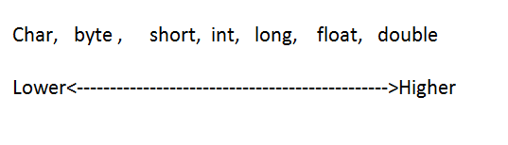
Casting Primitive data types
It is possible to convert one primitive into another.
This can be done in two ways:
Widening and narrowing.
The primitive data types are classified into two types:
Lower types---- occupies less memory-less digits
Higher types– occupies more memory- more digits
Boolean is not included earlier.- cannot convert.

Slide 6
Widening.
Converting lower type into higher type is called widening.
char ch=‘A’;
Int num = (int) ch; // Ascii value 65
int x=9500;
float sal=(float)x; // sal 9500.0.
Widening is safe because there will not be any loss of data or precision
Above statements we can write with out cast operator.

Slide 7
What is implicit casting?
Automatic casting done by the compiler internally is called implicit casting.
Implicit casting is done to convert a lower data type into higher data type.
Narrowing in primitive data types
Converting a higher data type into a lower data type is called “Narrowing”.
int n =66;
char ch = (char)n;// here ch contains B.
double d =12.6789;
int n = (int)d // n stores 12.
Here we are losing the data

Slide 8
So narrow is not safe.
This is the reason. Java compiler forces the programmer to use cast operator when going for narrowing.
The programmer should compulsory cast the data type.
So narrowing is also called explicit casting
What is explicit casting?
The casting done by a programmer is called explicit casting.
Explicit casting is compulsory while converting from a higher to a lower data type.

Slide 9
Casting Referenced Data type.
A class is a referenced data type.
Converting a class type into another class type is possible through casting.
But the classes should have some relationship between them by the way of inheritance.
Ex : we cannot convert Dog class into Horse class.
But you can convert a college class into a university class, since college is derived from university.
You can convert a department into a college.
Since department is a sub class of college.

Slide 10
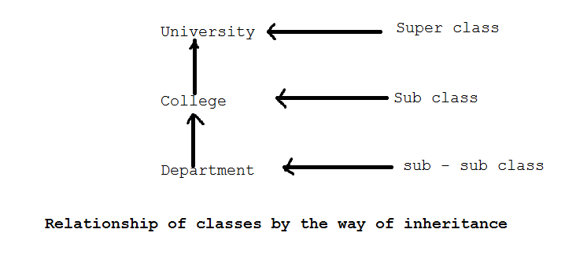
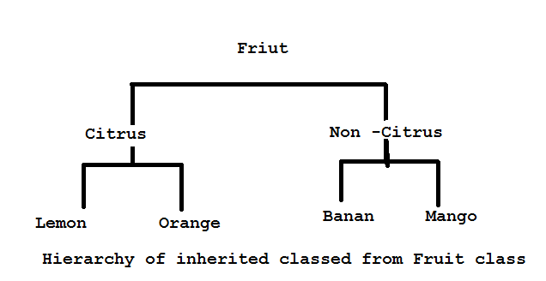
Generalization and Specialization

Slide 11
When we talk about a fruit, remember we are talking in general, it may represents any kind of fruit. Here scope is widened.
If we talk about citrus, then we came one step in inheritance and hierarchy and thus we eliminate the other types of fruits, so we are becoming more specific.
If we still come down to lemon, we are pin-pointing the type of fruit.
It is lemon only and not any other fruit. This is very specific.
This means when we come down from super class to sub classes we are becoming more and more specific.
When we go back from sub classes to super class, we are becoming more general.

Slide 12
Converting a sub class type into a super class type is called “Generalization. Because we are making sub class to become more general and its scope is widening.
This is also called widening and up casting.
Widening is safe because class will become more general.
Java compiler will not ask for any cast operator. It will do implicit casting.
Converting the super class into a sub class type is called “Specialization”
Here coming down from more general to a specific type and hence scope is Narrowed.
This is also called down casting or narrow
Java compiler specifically ask the programmer to use the cast operator.

Slide 13
What is generalization and specialization?
Generalization is a phenomenon where sub class is promoted to a super class and hence becomes more general.
Generalization needs widening or up-casting.
Specialization is a phenomenon where super class is narrowed down to a sub class.
Specialization needs narrowing or down-casting.

Slide 14
Generally any class reference can be used to refer that class object only.
Employee e = new Employee();
e is used to refer Employee class object.
Suppose class One and Class Two are two related classes:
Class One// super class
Class One extends class Two // Two is sub class of One
Now super class reference :
One o = new One() // super class object
Two t = new Two() // sub class reference to refer Two’s Object
Here in the above cases, we don’t require any casting.
Left side and right side of assignment operator, we have same data type.

Slide 15
But when we, try to use reference to refer to a different class object, we need casting.
One o = new Two();
At left side, we got the reference o whose data type is class One.
At right side, we got the object whose data type is class Two. So type casting is required.
One o = (One) new Two();// converting Two’s type as class One.
Here sub class object type is converted into super class.
This is an example for widening or up casting. No need of any cast operator.
Two t = (Two)new One(); .. Converting class one’s type as class Two.
We are converting super class into sub class…. Narrow and cast operator is needed.

Slide 16
Widening in Referenced Data Type
Super class reference to refer sub class object.
Converting sub class into super class.
In this case we can call show1() method of super class. But in this case it is not possible to call the show2() method in sub class;
Error :
The method show2() is undefined for the type One
In widening, the programmer can access all the super class methods, but not the sub class methods.
Suppose we override the super class methods in sub class, then it is possible to access sub class methods but not the super class methods.
Any how programmer will get 50% functionality.

Slide 17
Widening referenced data types.
package com.Typecast.in;
class One
{
void show1()
{
System.out.println("Super class method");
}
}
class Two extends One
{
void show2()
{
System.out.println("Super class method");
}
}
public class Cast {
public static void main(String[] args) {
// TODO Auto-generated method stub
One o;// o is super class reference
o=(One)new Two();// o is referring to sub class object
//widening
o.show1();
//o.show2();
}
}

Slide 18
Suppose we override the super class methods in sub class, then it is possible to access sub class methods but not the super class methods. Any how programmer will get 50% functionality.
package com.Typecast.in;
class One
{
void show1()
{
System.out.println("Super class method");
}
}
class Two extends One
{
void show1()
{
System.out.println("Sub class method");
}
}
public class Cast {
public static void main(String[] args) {
// TODO Auto-generated method stub
One o;// o is super class reference
o=(One)new Two();// o is referring to sub class object
//widening
o.show1();
}
}

Slide 19
Narrowing in Referenced Data type
package com.Typecast.in;
class One
{
void show1()
{
System.out.println("Super class method");
}
}
class Two extends One
{
void show2()
{
System.out.println("Sub class method");
}
}
public class Cast {
public static void main(String[] args) {
// TODO Auto-generated method stub
Two t;// o is super class reference
t=(Two)new One();// o is referring to sub class object
//widening
t.show1();
t.show2();
}
}

Slide 20
By observing the output.
t.show1() is not executing the super class method.
Another statement:
t.show2();
Will give the same error.
So in narrowing using super class object,
We cannot access any of the methods of the super class or sub class.
Will get 0% functionality.
The solution for this problem.
Let us not create an object to super class, as previous case.
This time , we create an object to sub class and use narrowing as,

Slide 21
package com.Typecast.in;
class One
{
void show1()
{
System.out.println("Super class method");
}
}
class Two extends One
{
void show2()
{
System.out.println("Sub class method");
}
}
public class Cast {
public static void main(String[] args) {
// TODO Auto-generated method stub
One o;// o is super class reference
o=(One)new Two();// o is referring to sub class object
Two t = (Two)o;
t.show1();
t.show2();
}
}

Slide 22
From the above program, we convert the super class reference type into sub class reference type.
Then using the sub class reference, we try to call the methods. From the preceding code, it is evident that if the object to sub class is created, it is possible to access all the methods of the super class as well the sub class.
Narrowing using sub class object will provide 100% functionality.
This is the reason in inheritance we create an object to sub class, but not super class.

Slide 23
Summarization points
If the super class reference is used to refer to super class, naturally all the methods of super class are accessible.
If the sub class reference is used to refer sub class object, all the methods of the super class as well sub class are accessible since the sub class object avails the copy of the super class.
If widening is done by using sub class object, only super class methods are accessible. If overridden, then the sub class methods are accessible.
If narrowing is done by using super class object, then none of the super class or sub class methods are accessible and this is useless.

Slide 24
If narrowing is done by using sub class object, then all the methods of both super and sub classes are available to the programmer
From the preceding points, we can understand that since object behavior is changed depends on which reference is used to refer the object, we can say that the object is exhibiting polymorphism.

Slide 25
The Object class
There is a class with name ‘Object’ in java.lang package which is the super class of all classes in java.
Every class in java is direct or indirect sub class of Object class.
Which is the super class for all classes including your classes also?
Object class.
Object class reference can store any reference of any object.
This become advantage when we want to write a method that needs to handle objects of unknown type.

Slide 26
protected Object | clone()Creates and returns a copy of this object.
boolean | equals(Object obj)Indicates whether some other object is "equal to" this one.
protected void | finalize()Called by the garbage collector on an object when garbage collection determines that there are no more references to the object.
Class<?> | getClass()Returns the runtime class of this Object.
int | hashCode()Returns a hash code value for the object.
void | notify()Wakes up a single thread that is waiting on this object's monitor.
void | notifyAll()Wakes up all threads that are waiting on this object's monitor.
String | toString()Returns a string representation of the object.
void | wait()Causes the current thread to wait until another thread invokes the notify() method or the notifyAll() method for this object.
void | wait(long timeout)Causes the current thread to wait until either another thread invokes the notify() method or the notifyAll() method for this object, or a specified amount of time has elapsed.
void | wait(long timeout, int nanos)Causes the current thread to wait until another thread invokes the notify() method or the notifyAll() method for this object, or some other thread interrupts the current thread, or a certain amount of real time has elapsed.

Slide 27
Let us compare the two objects using .equals() method of object class.
This method compares the object references of two objects and if both refer to same object then it gives true, otherwise false.
But in case of string objects and wrapper classes it compares the content.
Let us use getClass() method to know the class to which an object belongs.

Slide 28
Equals method
package com.Typecast.in;
class Myclass
{
int x;
Myclass(int x)
{
this.x=x;
}
}
public class Compare {
public static void main(String[] args) {
// create two Myclass objects with same content.
//In this case, references of objects will be different.
Myclass obj1= new Myclass(15);
Myclass obj2= new Myclass(15);
//create two wrapper class objects and store same content.
//In this case, references of objects will be different.
Integer obj3 = new Integer(15);
Integer obj4 = new Integer(15);
if(obj1.equals(obj2))
System.out.println("Obj1 and obj2 both are same");
else
System.out.println("Obj1 and obj2 both are not same");
if(obj3.equals(obj4))
System.out.println("Obj3 and obj3 both are same");
else
System.out.println("Obj3 and obj4 both are not same");
}
}

Slide 29
To get the class name.
package com.Typecast.in;
class Myclass1{
int x;
Myclass1(int x)
{
this.x=x;
}
}
//This class contains method to receive an object and display the classname
class KnowName {
static void printName(Object obj)
{
//get the class name into an object c of the class class
Class c=obj.getClass();
//get the name of the class using getName()
String name=c.getName();
System.out.println("The classname="+name);
}
}
public class ClassName_know {
public static void main(String[] args) {
// create Myclass object obj
Myclass1 obj= new Myclass1(10);
//know the class name of the object obj by calling printName;
KnowName.printName(obj);
}
}

Slide 30
Cloning the class objects.
The process of creating an exact copy of an existing object is called ‘cloning’
In cloning, already an object should exist and when we clone the object, a bit wise copy of the object will result.
The original and cloned object will be exactly the same bit to bit.
If original object has some data in it, it also automatically comes into cloned object.
Two types of cloning:
When the cloned object is modified, same modification will also effect the original object.-----Shallow cloning
When the cloned object is modified, if original object is not modified, then it is ---------Deep cloning.

Slide 31
Why we need cloning?
When we have new operator to create the objects, why we need the cloning technology?
Let us take object1 which is created by using new operator. There is a lot of processing done on the object, so the content of the object has been drastically changed and let us call it object2.
At this intermediate stage , we want another copy of this object.
There are two ways:
Using new operator and it starts with initial values, so the same process is repeated on object to get the intermediate object2.
Other way is to clone object2, so we get the exact copy of object. This preserves a copy of intermediate object and hence original object and cloned objects can be processed separately.
This method is easy as we can avoid lot if processing to be done on the object.

Slide 32
Steps to clone the objects of a class.
The class whose object to be cloned should implement Cloneable interface. This is available in java.lang package.
Cloneable interface indicates the class objects are cloneable.
If this is not implemented, then that class cannot be cloned and gives CloneNotSupportedException.
clone() method of object class is used for cloning. Object is the super class for every class.
Let us write our own method in the class and call clone() method.
public Object myClone() //our own method
{
return super.close();// create cloned object and return it.
}

Slide 33
it is also possible to create a cloned object, by overriding the clone() method of object.
Since clone() method is defined as protected Object clone() method in Object class, we can write our clone() method.
protected Object clone()
{ return super.clone();
}

Slide 34
Cloning program
package com.Typecast.in;
//Cloning example
class Employee implements Cloneable
{
//instance vars
int id;
String name;
// parameterized constructor
public Employee(int id, String name) {
this.id=id;
this.name=name;
}
// method to display the details:
void getData()
{
System.out.println("Id= "+ id);
System.out.println("Name= "+ name);
}
//clone the present class object.
public Object myClone() throws CloneNotSupportedException {
return super.clone();
}
}
public class CloneDemo {
public static void main(String[] args) throws CloneNotSupportedException {
// TODO Auto-generated method stub
Employee e1 = new Employee(10, "Ravichandra");
System.out.println("Original Object");
e1.getData();
// create another object by cloning e1. As myClone() method returns object of object class type
//it shoould be converted into Employee type
Employee e2= (Employee)e1.myClone();
System.out.println("Cloned Object");
e2.getData();
}
}

Slide 35
Interview questions
Which method is used in cloning?
clone() method of Object class is used in cloning.
Can you write an interface with our any methods?
Yes.
What do you call the interface with out any members?
An interface without any methods is called marking interface or tagging interface. It marks the class objects for a special purpose.
For example Cloneable(java.lang) and Serializable(java.io) are two marking interfaces or tagging interfaces. It indicates that particular class objects are cloneable.
Serializable indicates that particular class objects are serializable.

